Slide 1

107- PCA Principal Component Analysis
Sunil Gorantla

Slide 2
Introduciton
What is PCA?
PCA is a dimensionality reduction technique.
It identifies the most important features (principal components) that capture the maximum variance in the data.
Why use PCA?
Reduces complexity while retaining the most significant information.
Helps visualize high-dimensional data.
Mitigates the curse of dimensionality.

Slide 3
x | y
4 | 0
5 | 0
9 | 0

Slide 4
PCA
Key Steps:
Standardize the data.
Compute the covariance matrix.
Find the eigenvalues and eigenvectors of the covariance matrix.
Project the data onto the principal components.

Slide 5











Slide 6

X1 | X2 | X1_new = F(X1, X2) | X2_New
2 | 4 | 18 | 0
5 | 10 | 20 | 0
8 | 16 | 32
9 | 18
11 | 22
14 | 28
17 | 34

Slide 7



























Principal Component Analysis
X2
Y1
Y2
x
x
x
x
x
x
x
x
x
x
x
x
x
x
x
x
x
X1
x
x
x
x
x
x
x
x

Slide 8
Principal Component Analysis: one attribute first
Temperature
42
40
24
30
15
18
15
30
15
30
Question: how much spread is in the data along the axis? (distance to the mean)
Variance=Standard deviation^2

Slide 9
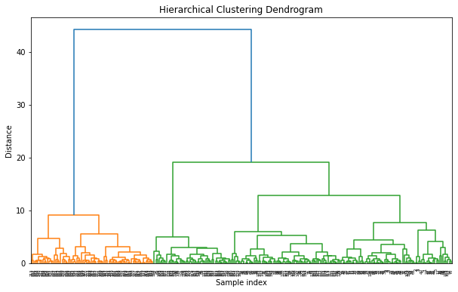


Slide 10






Now consider two dimensions
Covariance: measures the correlation between X and Y
Cov(X,Y)=0: independent
Cov(X,Y)>0: move same dir
Cov(X,Y)<0: move oppo dir
X=Temperature | Y=Humidity
40 | 90
40 | 90
40 | 90
30 | 90
15 | 70
15 | 70
15 | 70
30 | 90
15 | 70
30 | 70
30 | 70

Slide 11








Slide 12
More than two attributes: covariance matrix
Contains covariance values between all possible dimensions (=attributes):
Example for three attributes (x,y,z):

Slide 13


Eigenvalues & eigenvectors
Vectors x having same direction as Ax are called eigenvectors of A (A is an n by n matrix).
In the equation Ax=λx, λ is called an eigenvalue of A.

Slide 14











Slide 15



Eigen values & eigen vectors
Eigenvalues and Eigenvectors:
Eigenvectors define the directions of the new feature space (principal components).
Eigenvalues represent the magnitude of variance in the direction of the eigenvectors.
Ax=λx ⇔ (A-λI)x=0
Where:
A is the covariance matrix.
x is the eigenvector.
λ is the eigenvalue.

Slide 16



















Slide 17
Principal components
1. principal component (PC1)
The eigenvalue with the largest absolute value will indicate that the data have the largest variance along its eigenvector, the direction along which there is greatest variation
2. principal component (PC2)
the direction with maximum variation left in data, orthogonal to the 1. PC
n general, only few directions manage to capture most of the variability in the data.

Slide 18
Steps of PCA
Let be the mean vector (taking the mean of all rows)
Adjust the original data by the mean
X’ = X –
Compute the covariance matrix C of adjusted X
Find the eigenvectors and eigenvalues of C.
For matrix C, vectors e (=column vector) having same direction as Ce :
eigenvectors of C is e such that Ce=λe,
λ is called an eigenvalue of C.
Ce=λe ⇔ (C-λI)e=0
Most data mining packages do this for you.

Slide 19
Eigenvalues
Calculate eigenvalues λ and eigenvectors x for covariance matrix:
Eigenvalues λ_{j} are used for calculation of [% of total variance] (V_{j}) for each component j:

Slide 20
Principal components - Variance

Slide 21
Transformed Data
Eigenvalues λ_{j} corresponds to variance on each component j
Thus, sort by λ_{j}
Take the first p eigenvectors e_{i;} where p is the number of top eigenvalues
These are the directions with the largest variances

Slide 22
An Example
X1 | X2 | X1' | X2'
19 | 63 | -5.1 | 9.25
39 | 74 | 14.9 | 20.25
30 | 87 | 5.9 | 33.25
30 | 23 | 5.9 | -30.75
15 | 35 | -9.1 | -18.75
15 | 43 | -9.1 | -10.75
15 | 32 | -9.1 | -21.75
30 | 73 | 5.9 | 19.25
Mean1=24.1
Mean2=53.8

Slide 23
Covariance Matrix
75 | 106
106 | 482
C=
Eigenvectors:
e1=(-0.98,-0.21), λ1=51.8
e2=(0.21,-0.98), λ2=560.2
Thus the second eigenvector is more important!

Slide 24
If we only keep one dimension: e2
yi
-10.14
-16.72
-31.35
31.374
16.464
8.624
19.404
-17.63
We keep the dimension of e2=(0.21,-0.98)
We can obtain the final data as

Slide 25
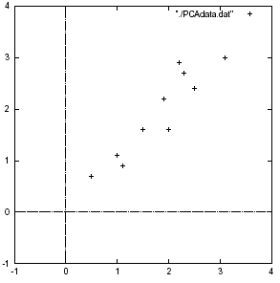
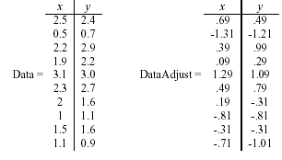

Slide 26
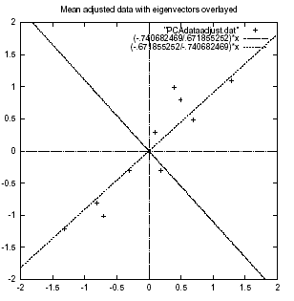

Slide 27
PCA –> Original Data
Retrieving old data (e.g. in data compression)
RetrievedRowData=(RowFeatureVector^{T} x FinalData)+OriginalMean
Yields original data using the chosen components

Slide 28
Principal components
General about principal components
summary variables
linear combinations of the original variables
uncorrelated with each other
capture as much of the original variance as possible

